Slide 1
Comparison Charts Infographics
Analysis of different brands and products.
Version 1
Business professionals like you connecting to share advice.
Version 2
Business professionals like you connecting to share advice.

Slide 2
Comparison Charts Infographics
Analysis of different brands and products.
35%
80%
65%
Business professionals like you connecting to share advice.
Business professionals like you connecting to share advice.
Business professionals like you connecting to share advice.

Slide 3
Comparison Charts
Infographics
Analysis of different brands and products.
Business professionals like you connecting.
Business professionals like you connecting.
Business professionals like you connecting.
Business professionals like you connecting.

Slide 4
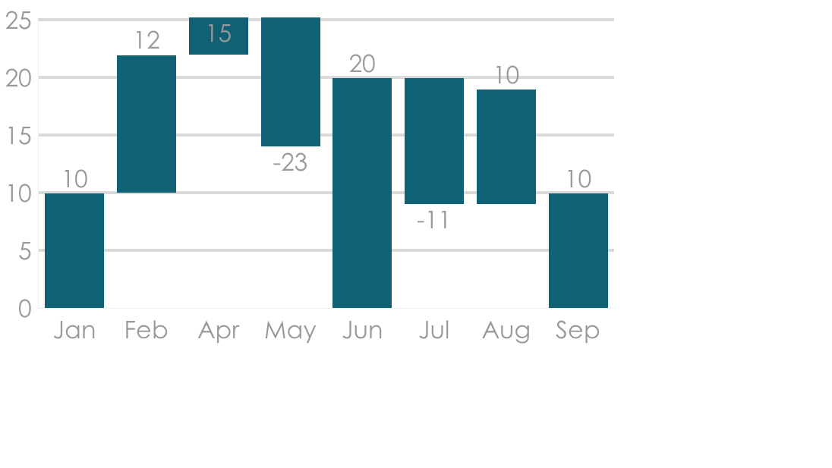
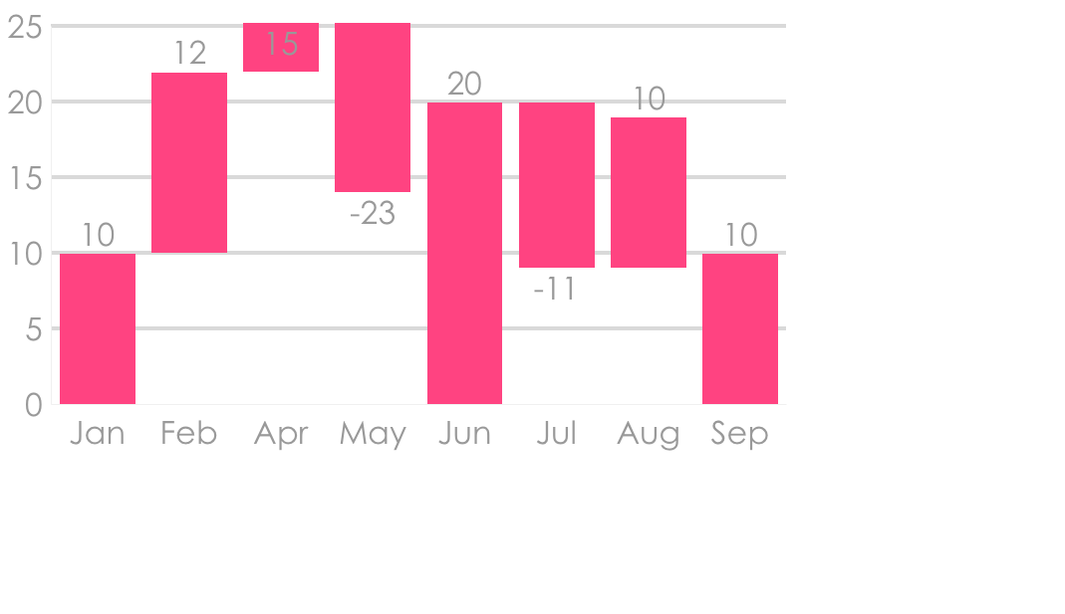
Comparison Charts Infographics
Analysis of different brands and products.
Version 1
Version 2
Business professionals like you connecting to share advice.
Business professionals like you connecting to share advice.

Slide 5
Comparison Charts Infographics
Analysis of different brands and products.
2019
2020
65%
35%
60%
40%
Business
Community
Business
Community
Business professionals like you connecting to share advice.
Business professionals like you connecting to share advice.
Business professionals like you connecting to share advice.
Business professionals like you connecting to share advice.

Slide 6
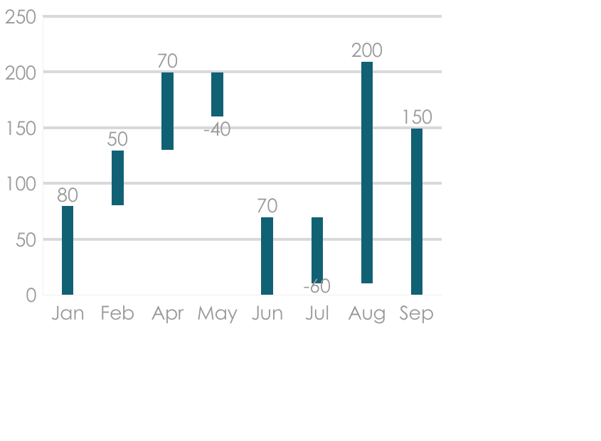
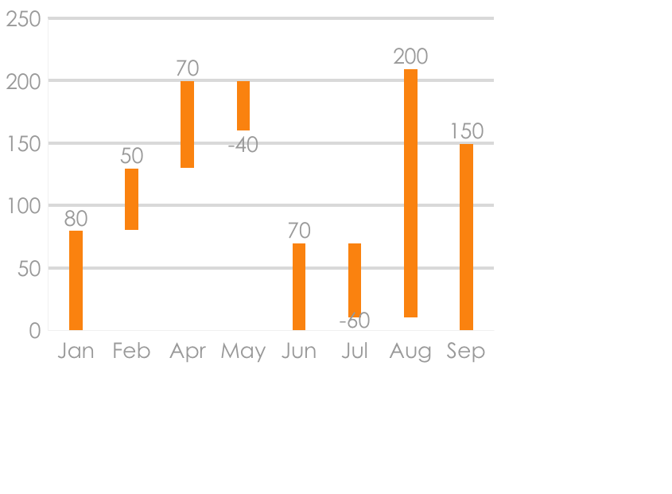
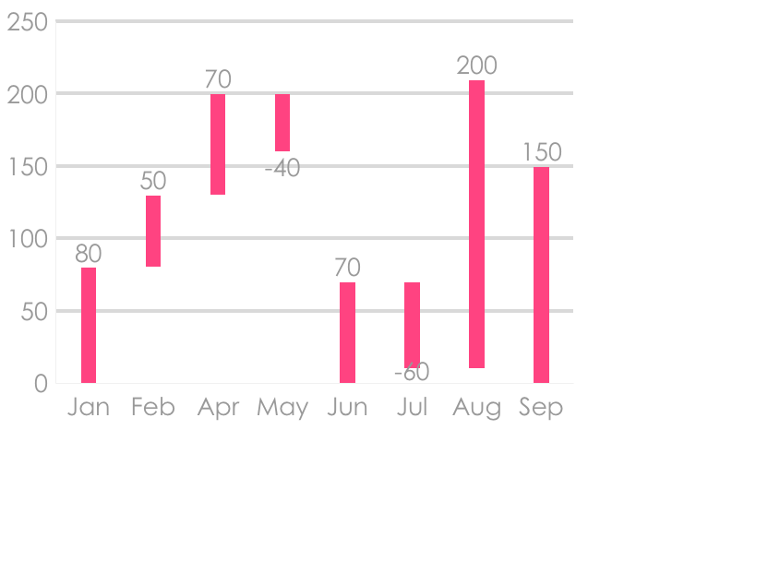
Comparison Charts Infographics
Analysis of different brands and products.
Business System
Suppliers
Community
Business professionals like you connecting.
Business professionals like you connecting.
Business professionals like you connecting.

Slide 7
Comparison Charts Infographics
Analysis of different brands and products.
65%
Women
Business professionals like you connecting to share advice.
35%
Men
Business professionals like you connecting to share advice.

Slide 8
Comparison Charts Infographics
Analysis of different brands and products.
Product | 2001 | 2002 | 2993
August | 234 | 234 | 122
September | 245 | 532 | 446
October | 765 | 234 | 567
November | 854 | 123 | 223

Slide 9
Comparison Charts Infographics
Analysis of different brands and products.
2019
2020
Business professionals like you connecting to share advice. Business professionals like you connecting to share advice
Business professionals like you connecting to share advice. Business professionals like you connecting to share advice

Slide 10
Comparison Charts Infographics
Analysis of different brands and products.
Version 1
Version 2
Business professionals like you connecting to share advice.
Business professionals like you connecting to share advice.

Slide 11
Comparison Charts Infographics
Analysis of different brands and products.
35%
35%
Version 1
Version 2
Business professionals like you connecting to share advice.
Business professionals like you connecting to share advice.

Slide 12
Comparison Charts Infographics
Analysis of different brands and products.
Version 1
Version 2
Version 3
Business professionals like you connecting to share advice.
Business professionals like you connecting to share advice.
Business professionals like you connecting to share advice.

Slide 13
Comparison Charts Infographics
Analysis of different brands and products.
Software | Basic | Pro | Advanced
Software 1 | $200 | $400 | $600
Software 2 | $300 | $800 | $1200
Software 3 | $400 | $120 | $1800
 | 100 | 100 | 100

Slide 14
Comparison Charts Infographics
Analysis of different brands and products.
Version 1
Version 2
Version 3
Business professionals like you connecting to share advice.
Business professionals like you connecting to share advice.
Business professionals like you connecting to share advice.

Slide 15
Comparison Charts Infographics
Analysis of different brands and products.
01
Competitors
Business professionals like you connecting.
02
Financial
Business professionals like you connecting.
03
Commerce
Business professionals like you connecting.

Slide 16
Comparison Charts Infographics
Analysis of different brands and products.
Business professionals like you connecting.
Business professionals like you connecting.
Business professionals like you connecting.
Business professionals like you connecting.

Slide 17
Comparison Charts Infographics
Analysis of different brands and products.
Subroutine
Subroutine
01
02
Delay
Delay
That’s why we provide point solutions
That’s why we provide point solutions
Business professionals like you connecting to share advice.
Data
Data
Business professionals like you connecting to share advice.
End
End

Slide 18
Comparison Charts Infographics
Analysis of different brands and products.
Products | Status | Process
Product 1 | Business professionals like you connecting.
Product 2 | Business professionals like you connecting.
Product 3 | Business professionals like you connecting.
18%
50%
35%

Slide 19
Comparison Charts Infographics
Analysis of different brands and products.
That’s why we provide point solutions
That’s why we provide point solutions
Business professionals like you connecting.
Business professionals like you connecting.
Business professionals like you connecting.
Business professionals like you connecting.

Slide 20
Comparison Charts Infographics
Analysis of different brands and products.
Sells 2019
Purchases 2019
Business professionals like you connecting to share advice.
Business professionals like you connecting to share advice.
Returns 2019
Expenses 2019
Business professionals like you connecting to share advice.
Business professionals like you connecting to share advice.

Slide 21
Comparison Charts Infographics
Analysis of different brands and products.
35%
Business professionals like you connecting to share advice.
65%
Business professionals like you connecting to share advice.

Slide 22
Comparison Charts Infographics
Analysis of different brands and products.
20%
Business professionals like you connecting to share advice.
30%
Business professionals like you connecting to share advice.
50%
Business professionals like you connecting to share advice.
Business
Business
Business

Slide 23
Comparison Charts Infographics
Analysis of different brands and products.
Business
Suppliers
Business professionals like you connecting to share advice.
Business professionals like you connecting to share advice.
Community
30%
Competitors
Business professionals like you connecting to share advice.
Business professionals like you connecting to share advice.
70%

Slide 24
Comparison Charts Infographics
Analysis of different brands and products.
That’s why we provide point solutions
Jan
Feb
March
Business
Business professionals like you connecting.
Jan
Feb
March
Suppliers
Business professionals like you connecting.
Jan
Feb
March
Community
Business professionals like you connecting.

